Slide 1


Safe Driving System
Graduation Project
2023

Slide 2

Supervisor
Prof. Amir Salah

Slide 3





Team Members
Youssef Madian
Asem Hefny
Mohamed Fathy
Mohamed Salah
Moemen El-Shazly

Slide 4

Why Do We Need “Safe Driving System” ?

Slide 5

Problem Statement
Every day, millions of people get behind the wheel, but what happens when a driver experiences a sudden health issue?

Slide 6
Statistics On Deaths And Accidents
Globally, an estimated 1.6 million people die each year in road traffic crashes. Of these, up to 10%
(130,000) are believed to be the result of drivers experiencing a health problem while driving.
The leading health problems that commonly cause drivers to be involved in accidents are:
[Sudden cardiac arrest-Stroke-Diabetes-Seizures]
1.6 Million
7.88 Billion
130 Thousands

Slide 7

The Need For A Solution !

Slide 8


Introduction About The Safe Driving System
This is where our solution “Safe Driving System” comes in. It's a three-part system consisting of a mobile
application and a wearable health device beside the hardware part in the simulator car.

Slide 9
Introduction About The Safe Driving System
The mobile application serves as the central hub, providing a user-friendly interface for drivers to interact with various features and receive vital health status information.

Slide 10
Introduction About The Safe Driving System
The wearable health device, on the other hand, monitors vital signs such as hearth rate and blood pressure and send this information to the mobile application.

Slide 11
Introduction About The Safe Driving System
The modified hardware in the simulator car allows us to automatically control the car through the application after a health defect occurs, where the car is stopped and distress messages are sent to the specified emergency numbers.

Slide 12


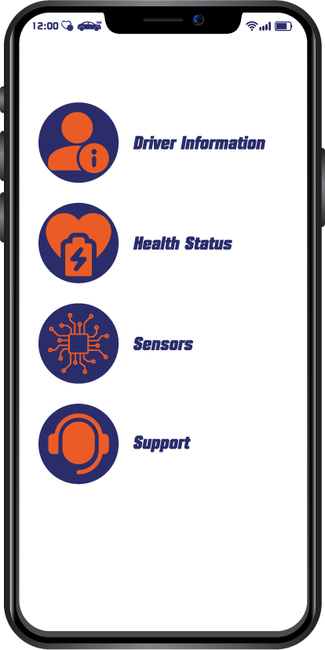
Project Overview
Wearable Device
Servo Motor180
DC Motor
ESP8266
Arduino
L298d H-Bridge
I2C Logic Converter
Application

Slide 13
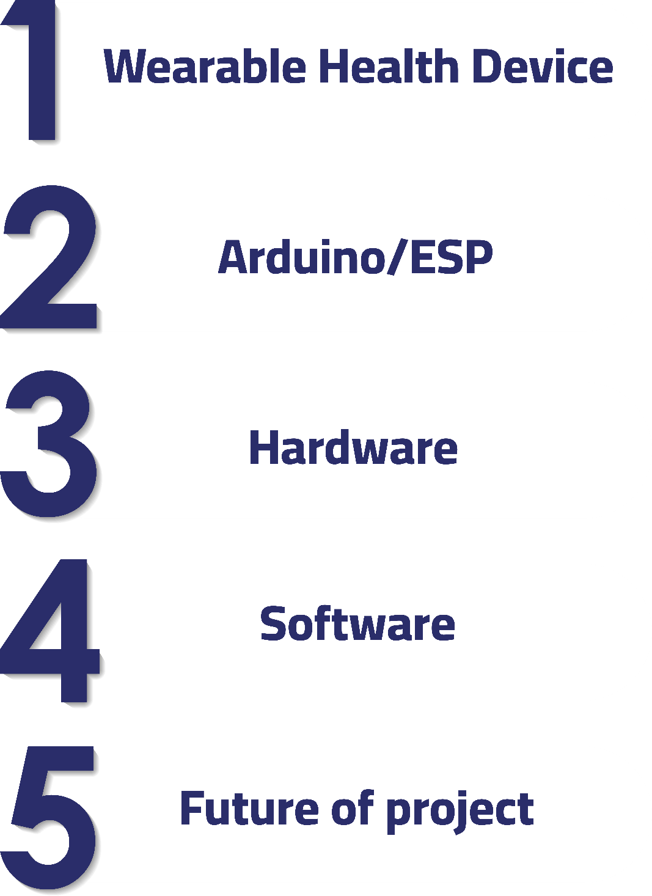
Outlines

Slide 14
Wearable Health Device

Slide 15
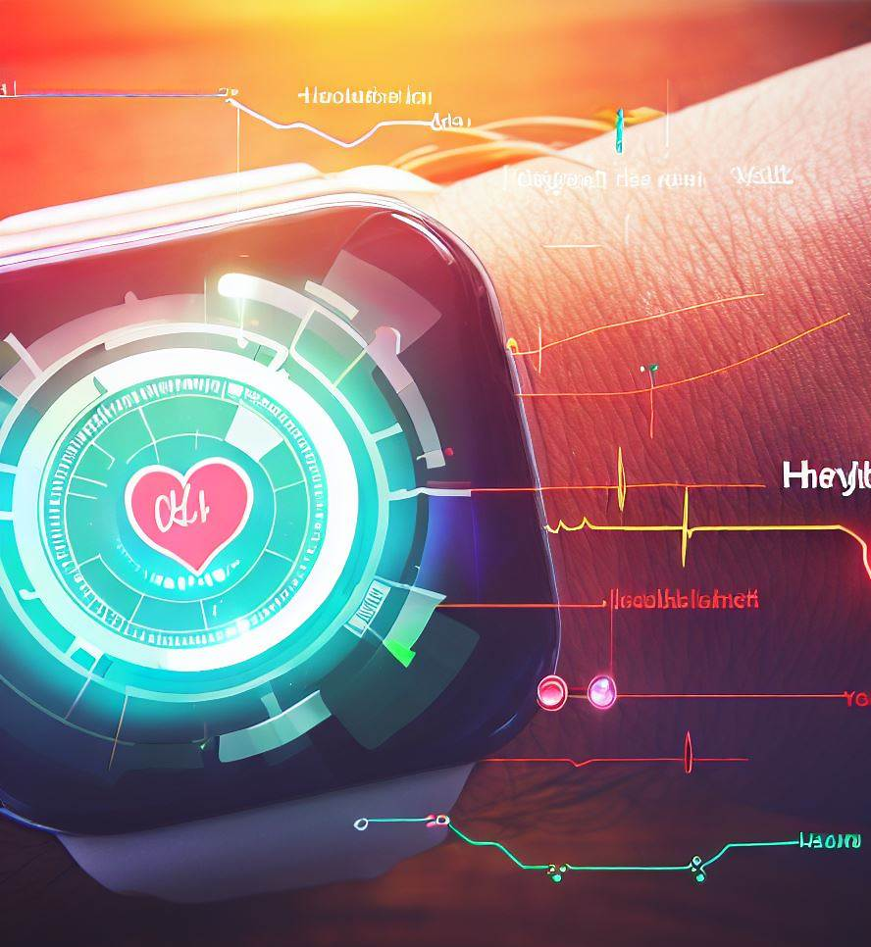
Why Did We Use This Part ?
Wearable
Remotely, monitoring the vital signs of the driver to early detection of health problems

Slide 16
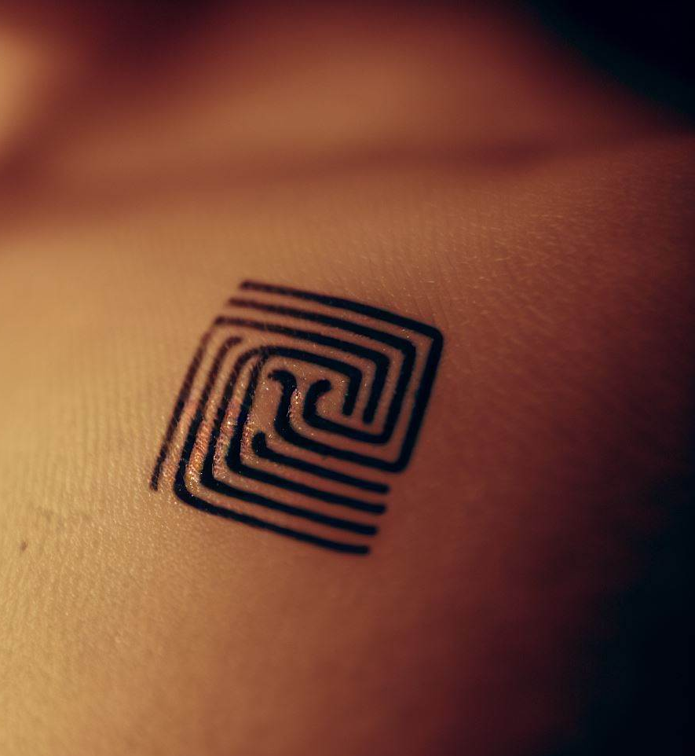
EX:
Wearable
RFID Tags
[RFID Tag Tattoo]

Slide 17
Arduino Uno

Slide 18






Arduino Uno
Why Did We Use This Part ?
Open hardware source
Micro controller board based on ATmega328p
Technical specifications

Slide 19
Technical Specifications
Arduino Uno
Microcontroller | ATmega328
Operating Voltage | 5V
Input Voltage (recommended) | 7-12V
Input Voltage (limits) | 6-20V
Digital I/O Pins | 14 (of which 6 provide PWM output)
Analog Input Pins | 6
DC Current per I/O Pin | 40 mA
DC Current for 3.3V Pin | 50 mA
Flash Memory | 32 KB (ATmega328) of which 0.5 KB used by boot loader
SRAM | 2 KB (ATmega328)
EEPROM | 1 KB (ATmega328)
Clock Speed | 16 MHz

Slide 20
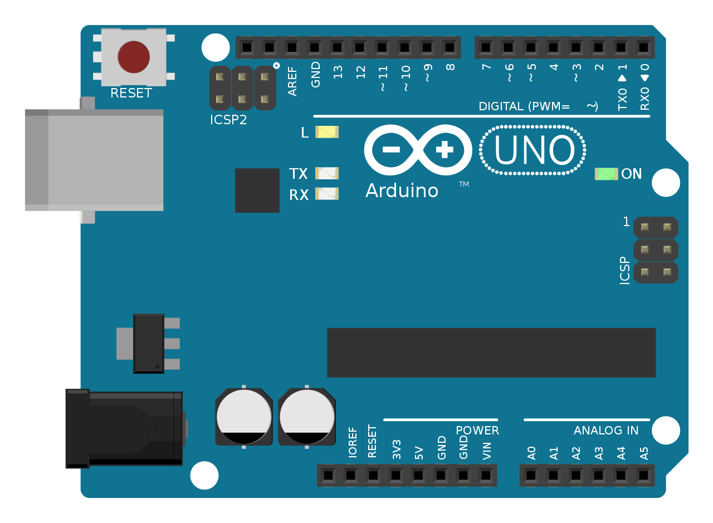
Digital input/output
Basic
Parts
Arduino Uno
ATMEGA16U2
Convert from
UART to USB
Reset button
USB
Input
voltage
7-12V
Output
5v&3.3V
Analog Inputs

Slide 21
ESP 8266

Slide 22

ESP 8266
Why Did We Use This Part ?
Easy to program: it can be programmed using the Arduino IDE.
Real-time monitoring: it can be used to connect sensors and other monitoring devices.
Wi-Fi capability: it’s equipped with Wi-Fi microcontroller, which allows it to connect to the internet and communicate with other devices over the network wirelessly.

Slide 23
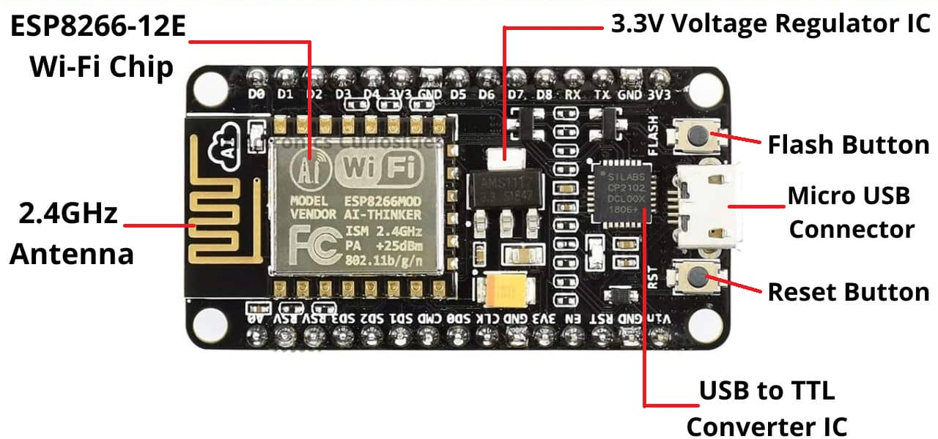
ESP 8266
NodeMCUBasic Parts

Slide 24
ESP
I2C
[Inter-Integrated Circuit]

Slide 25
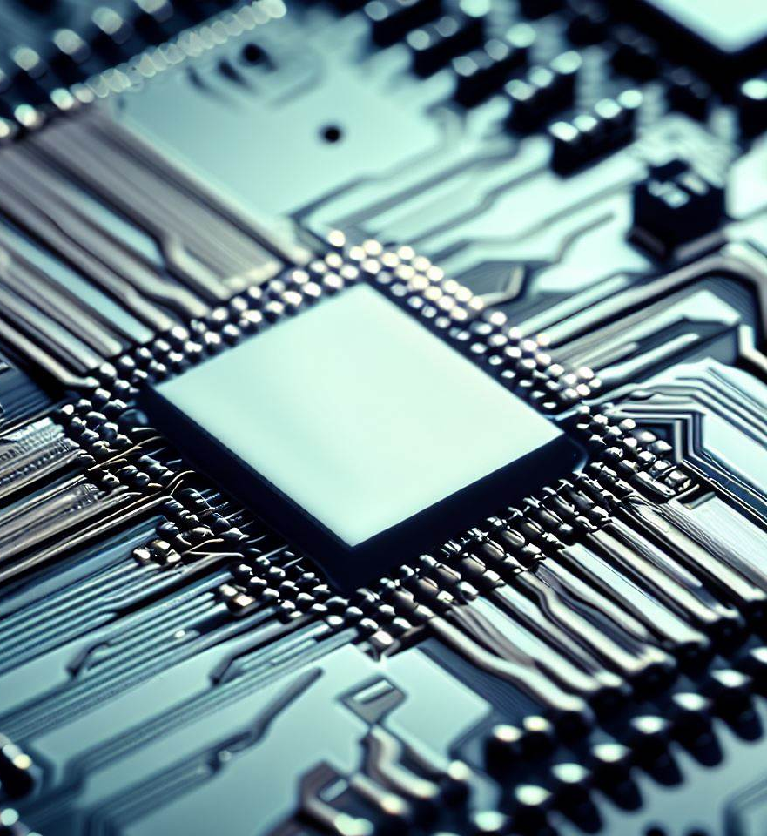
ESP 8266
What is I2C ?
It’s a protocol for communication between microcontrollers and other electronic devices.
The ESP8266 microcontroller [which is used in the ESP8266 and NodeMCU boards] has built-in hardware support for I2C communication.

Slide 26
Why Did We Choose I2C Not SPI?
ESP 8266
I2C is a simpler and slower protocol that operates in half-duplex mode.
I2C is a multi-master protocol, which means multiple devices can be connected to the same bus.
I2C is suitable for applications with low data rates and low power consumption, such as sensors, and real-time clocks.

Slide 27
How I2C Work ?
ESP 8266
Wired Used | 2 Wires
Max Speed | Standard Mode>100 kbps Fast Mode>400 kbps High Speed Mode>3.4 Mbps Ultra Fast Mode>5 Mbps
Synchronous or Asynchronous? | Synchronous
Serial or Parallel ? | Serial
Max # of Masters | Unlimited
Max # of Slaves | 1008

Slide 28
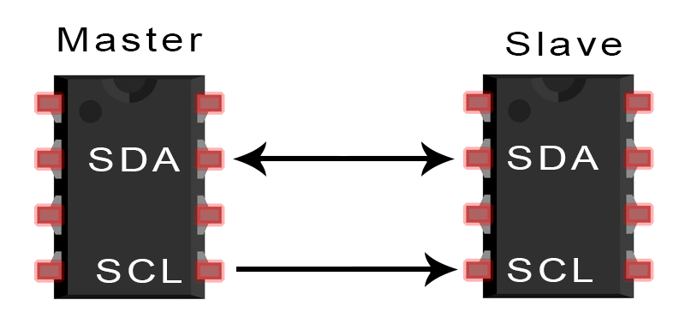
ESP 8266
How I2C Work ?
SDA (Serial Data) : The line for the master and slave to send and receive data.
SCL (Serial Clock) : The line that carries the clock signal.

Slide 29
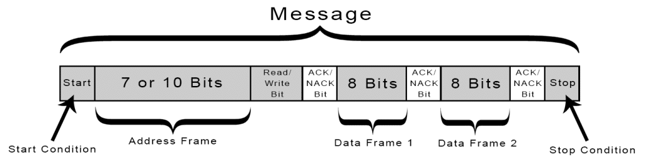
ESP 8266
I2C Frames
Start Condition
Stop Condition
Address Frame
Read/Write Bit
ACK/NACK Bit

Slide 30
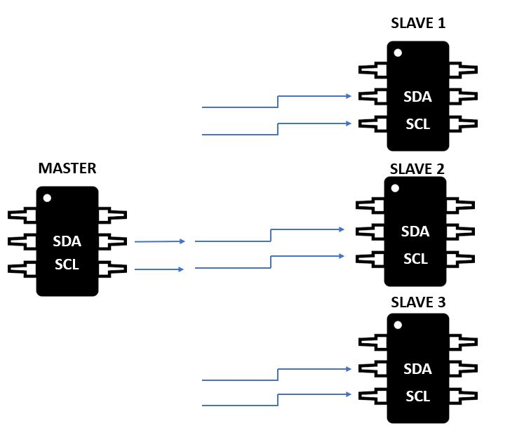
ESP 8266
STEPS OF I2C DATA TRANSMISSION
[1]

Slide 31
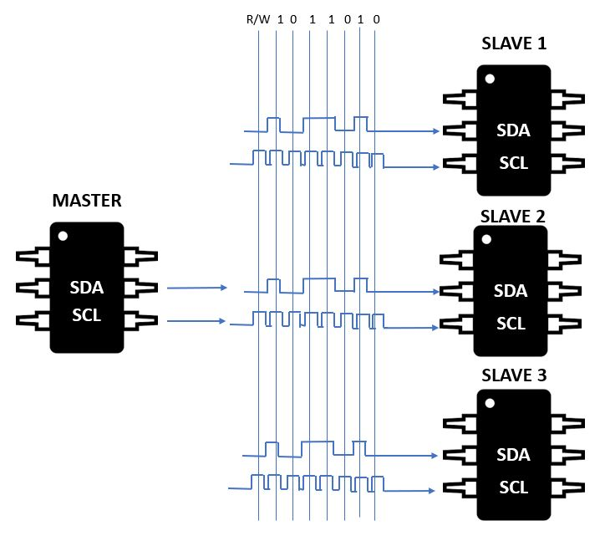
ESP 8266
STEPS OF I2C DATA TRANSMISSION
Address
0110000
[2]
Address
1001000
Address
0101101

Slide 32
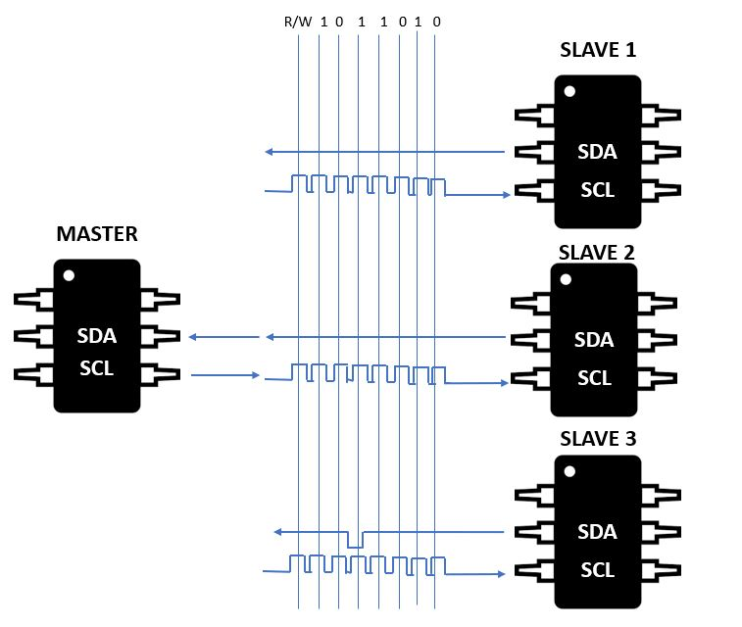
ESP 8266
STEPS OF I2C DATA TRANSMISSION
Address
0110000
[3]
Address
1001000
Address
0101101

Slide 33
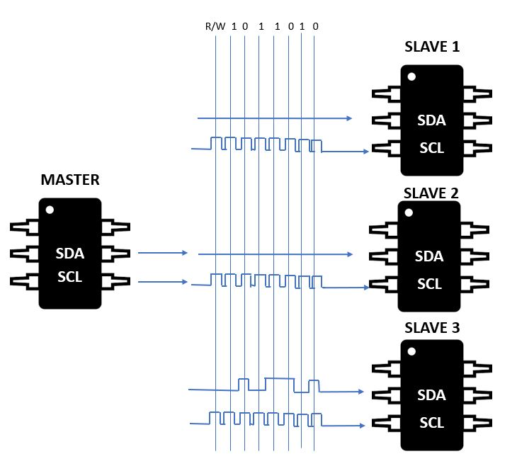
ESP 8266
STEPS OF I2C DATA TRANSMISSION
[4]

Slide 34
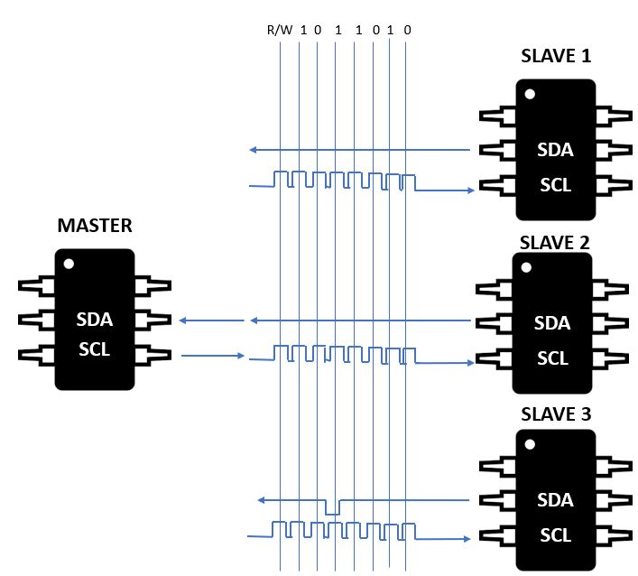
ESP 8266
STEPS OF I2C DATA TRANSMISSION
[5]

Slide 35

ESP 8266
STEPS OF I2C DATA TRANSMISSION
[6]

Slide 36
Hardware

Slide 37
Hardware
Basic Components
Arduino Uno
ESP2866-12E
L298d H-Bridge
DC-DC Converter Booster
Servo Motor 180°
DC Motor 5V
Li ion Charger Module
I2C Logic Converter
Battery Li ion 3.7V-2200mAh

Slide 38
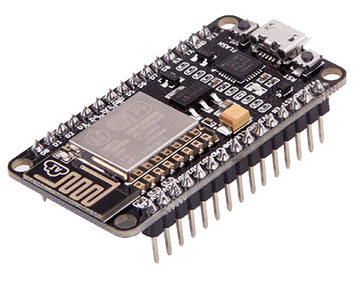
Hardware
NodeMCU

Slide 39
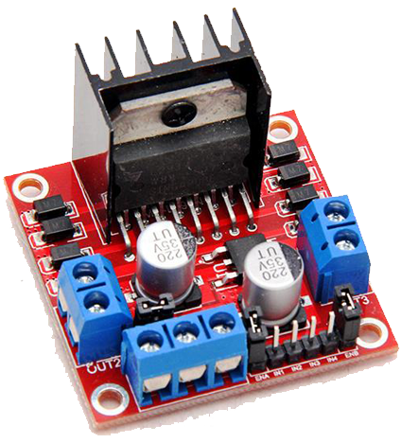
Hardware
DC H-Bridge

Slide 40
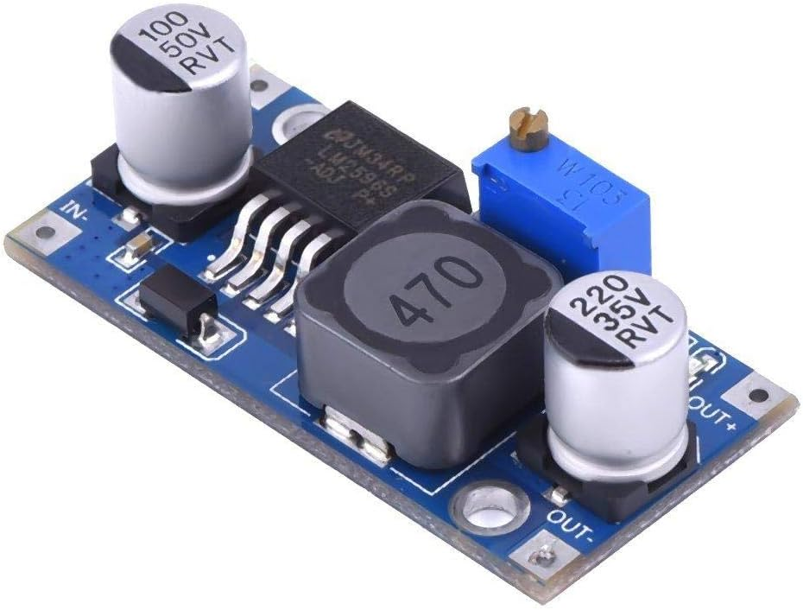
DC-DC Converter Booster
Hardware

Slide 41
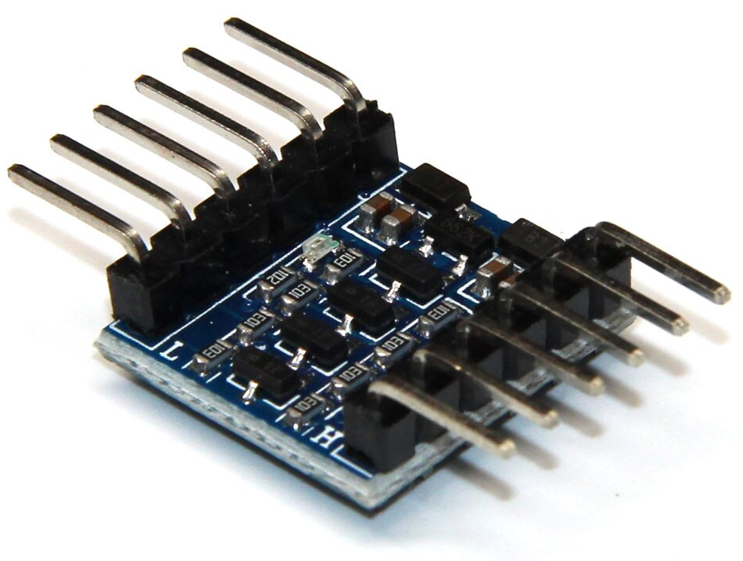
I2C Logic Converter
Hardware

Slide 42
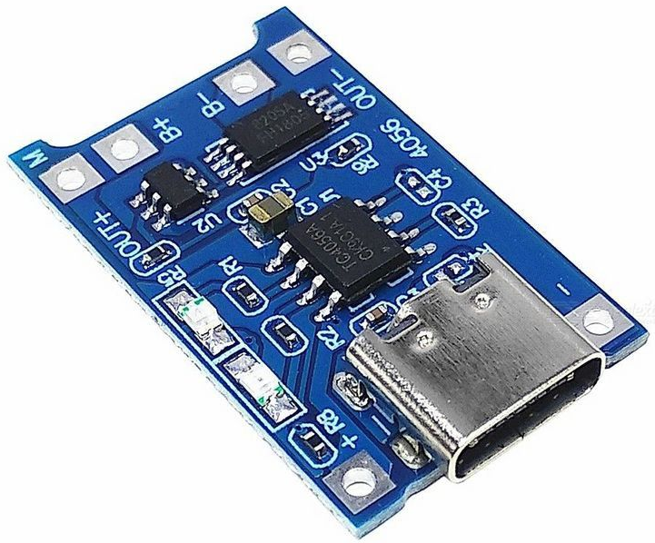
Hardware
Li ion Charger

Slide 43
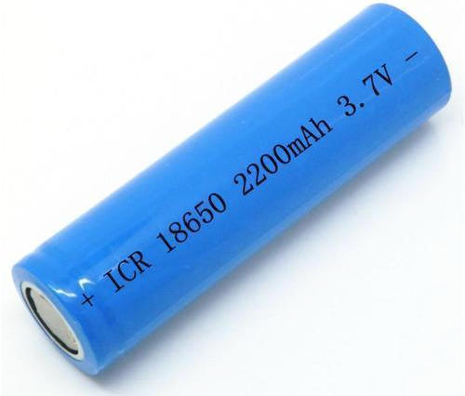
Hardware
Battery Li ion 3.7V

Slide 44
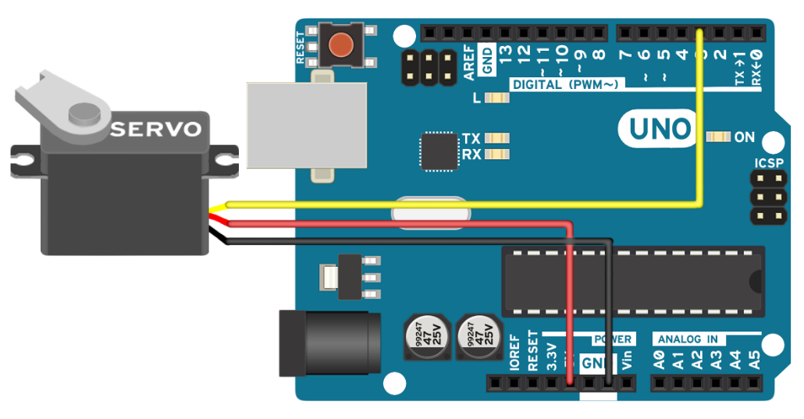
Hardware
Servo Motor

Slide 45
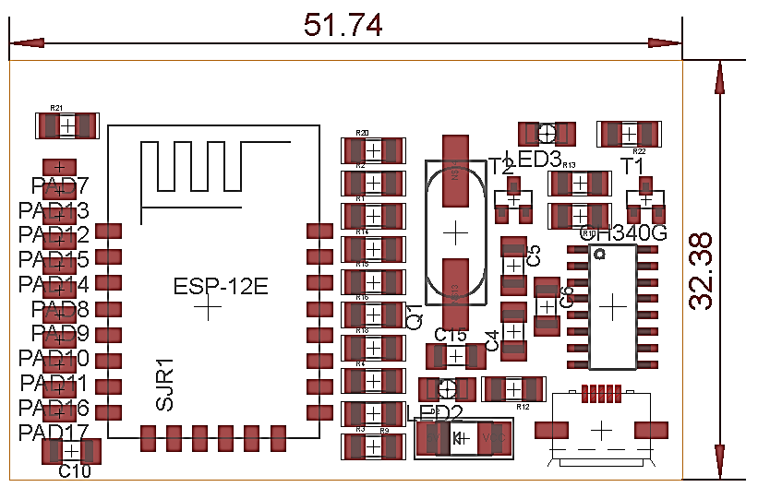
Car Circuit PCB
Top Part
Hardware

Slide 46
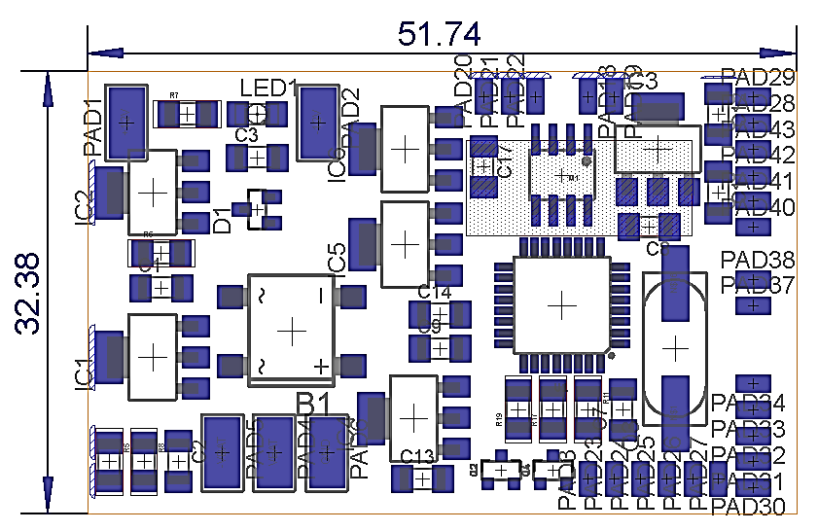
Car Circuit PCB
Bottom Part
Hardware

Slide 47
Software

Slide 48
Software
Software Parts
Mobile Application
Arduino Uno
ESP2866

Slide 49

Software
Mobile Application

Slide 50
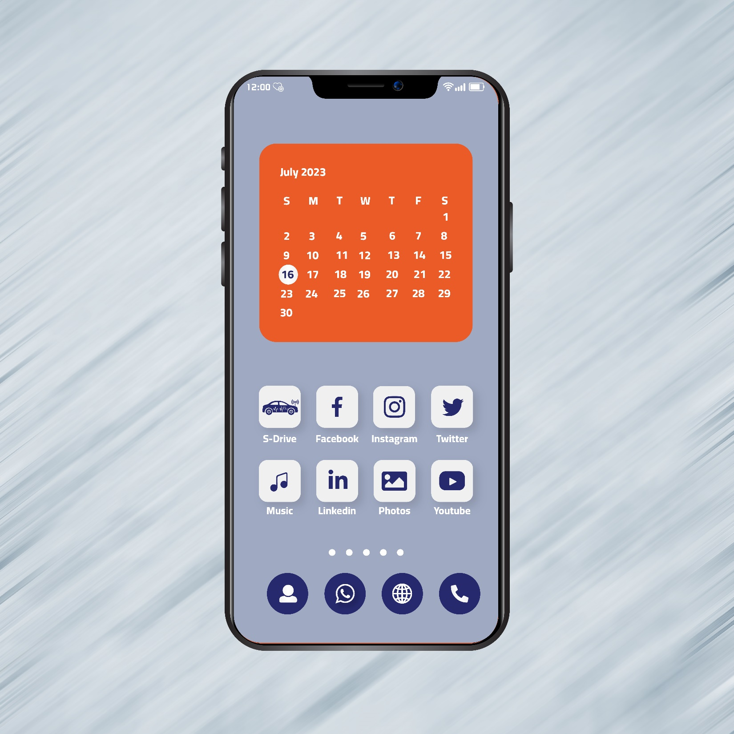
Software
Mobile Application
UI Design

Slide 51
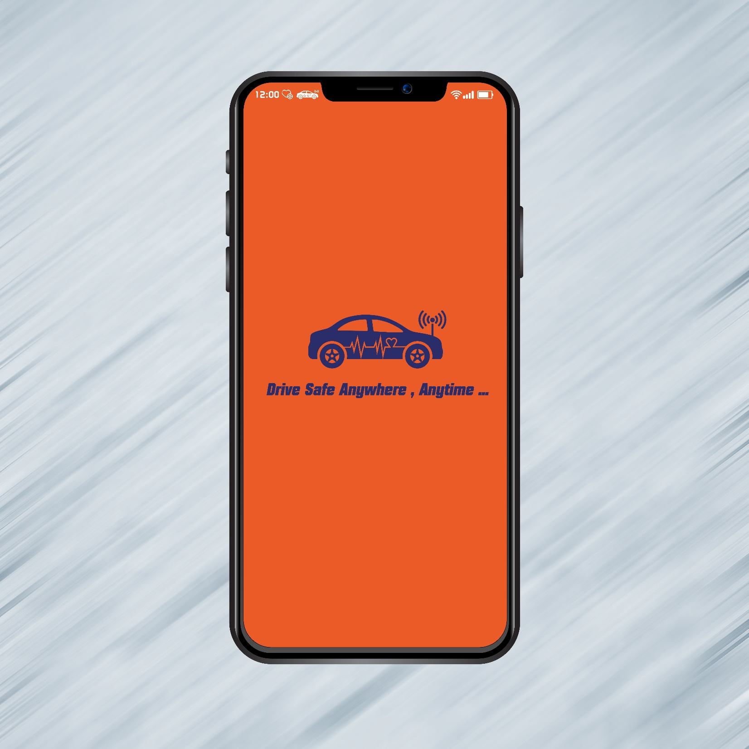
Software
Mobile Application
UI Design

Slide 52
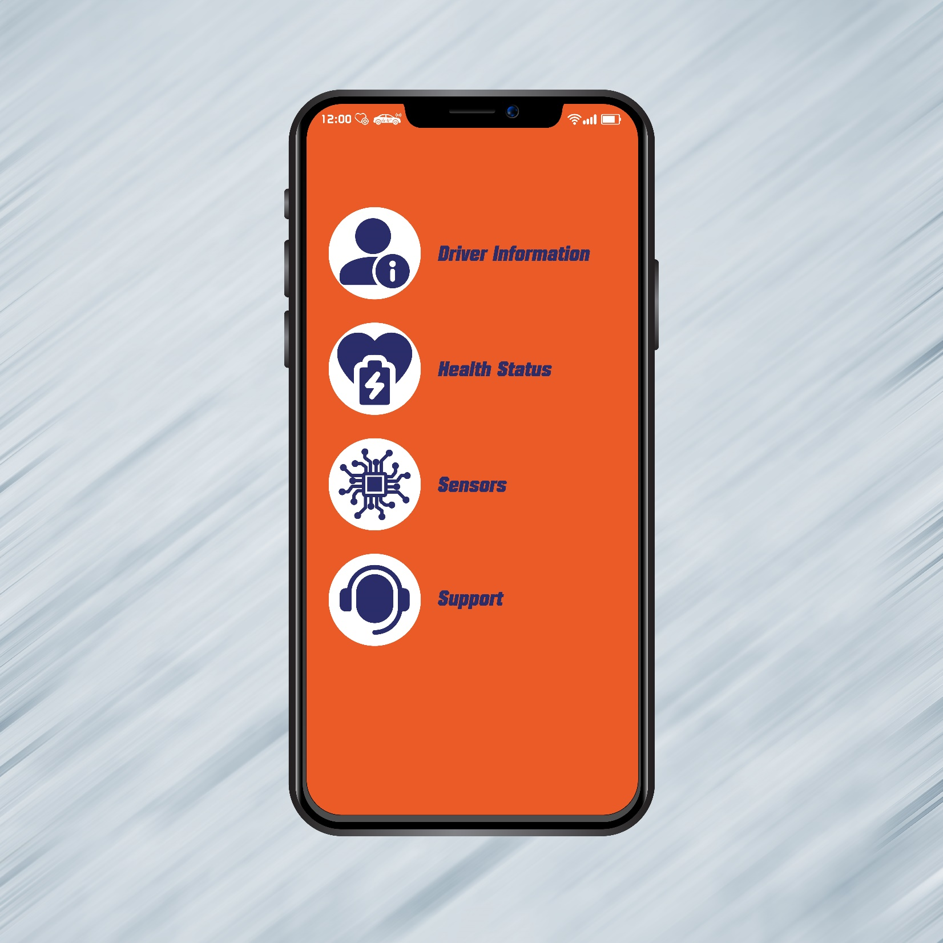
Software
Mobile Application
UI Design

Slide 53
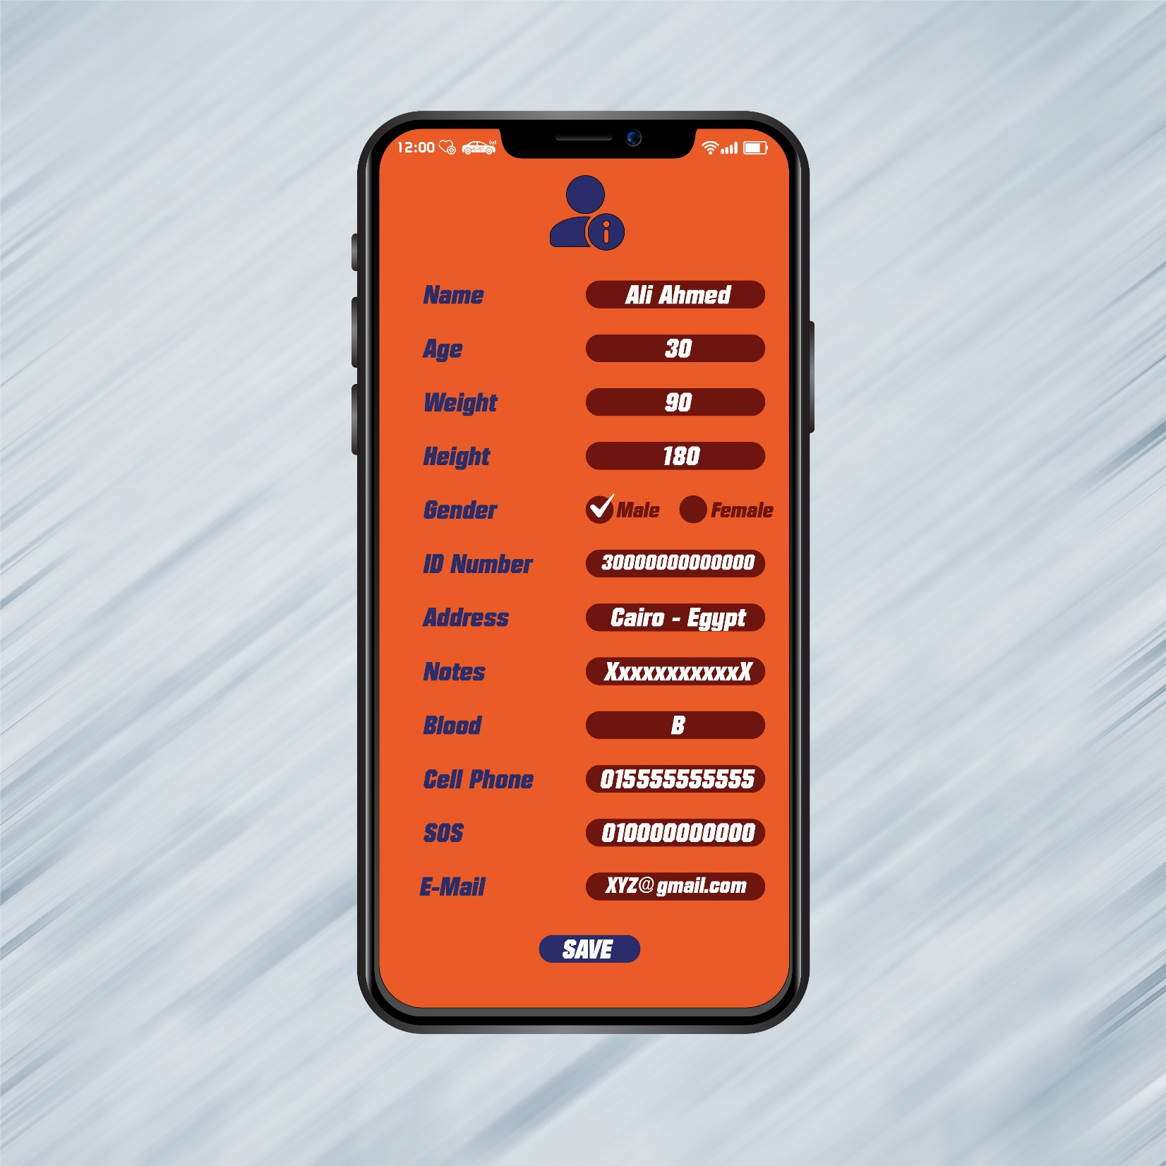
Software
Mobile Application
UI Design

Slide 54
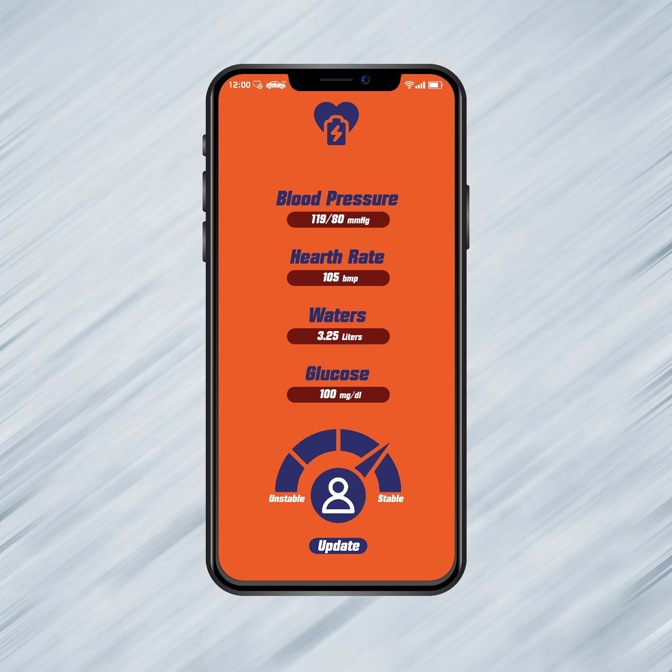
Software
Mobile Application
UI Design

Slide 55
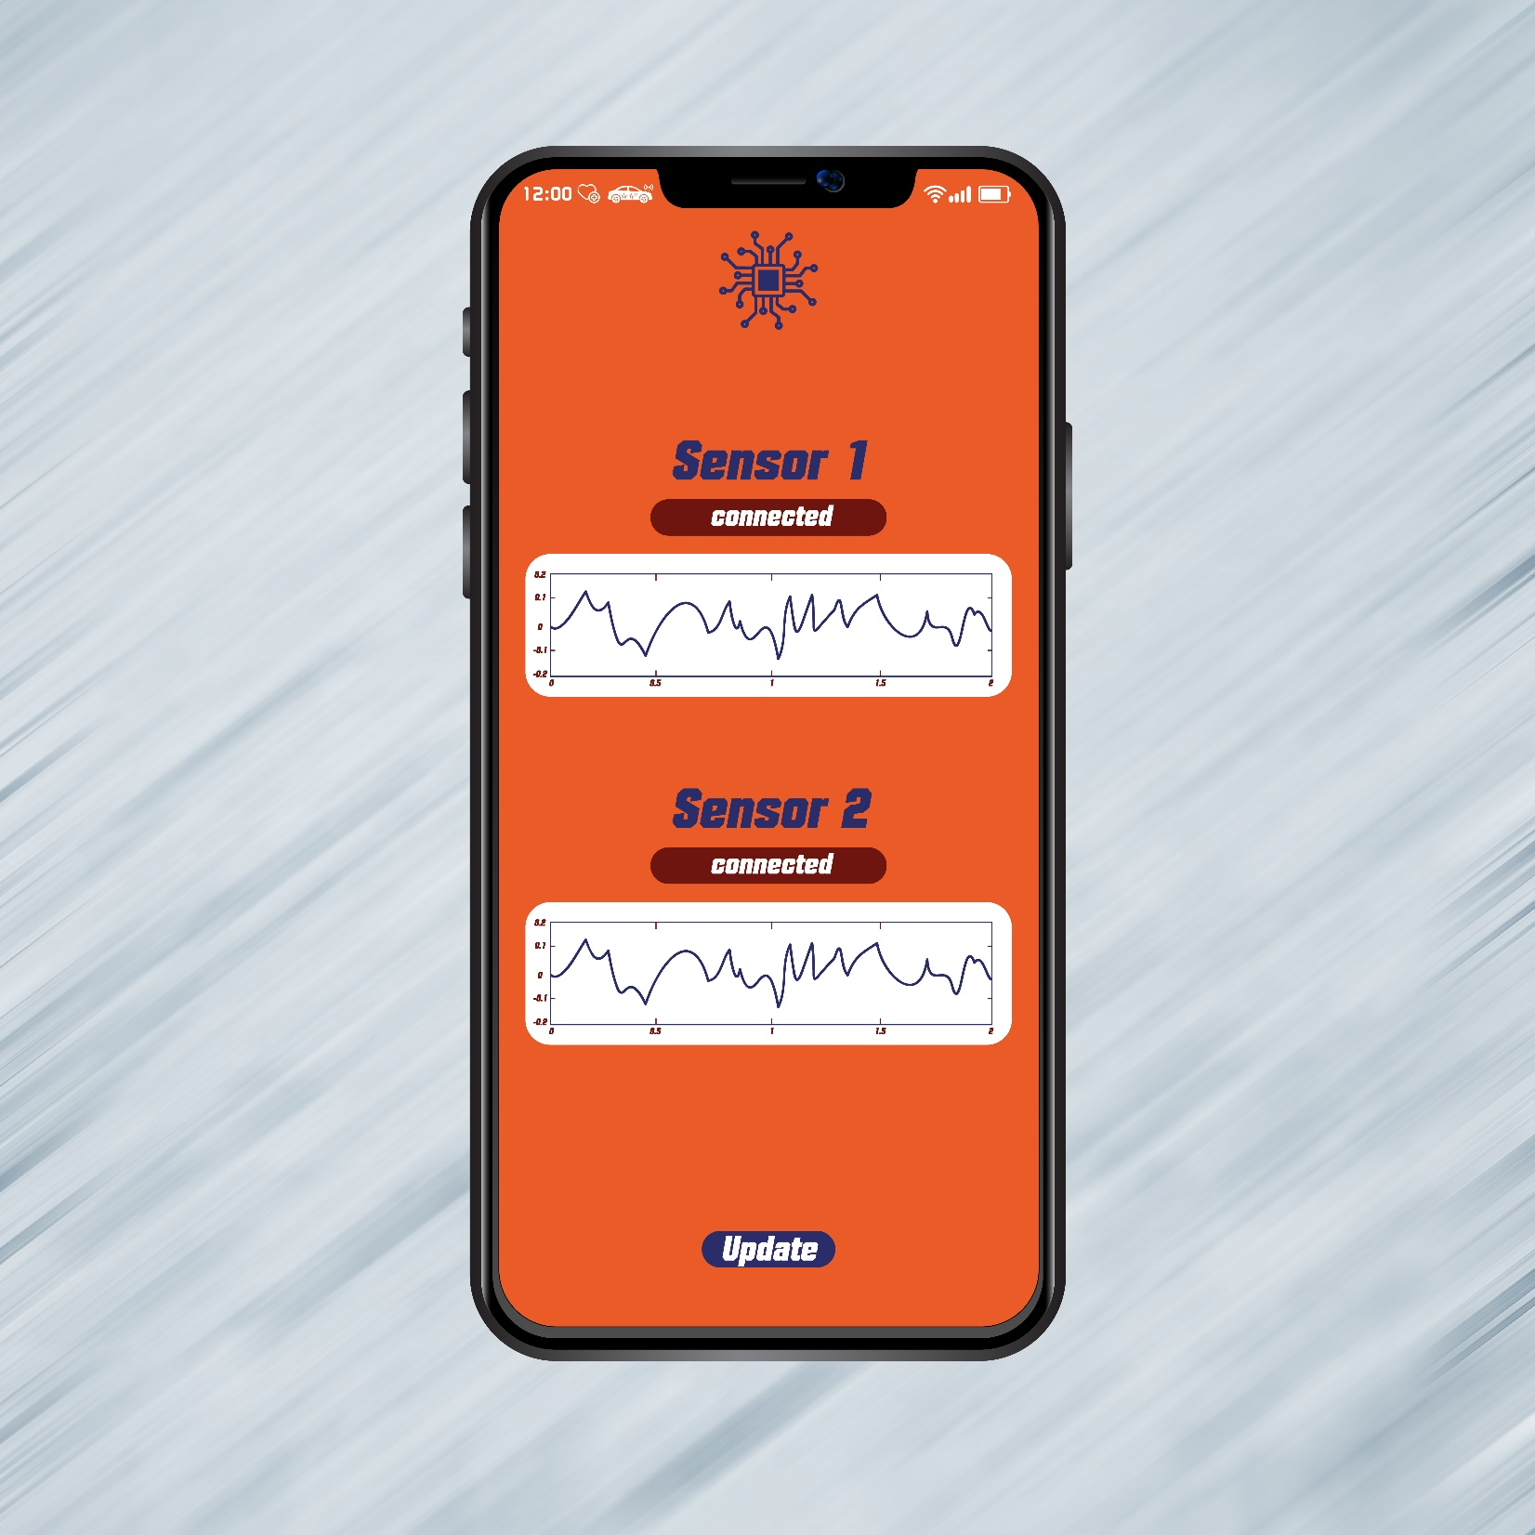
Software
Mobile Application
UI Design

Slide 56
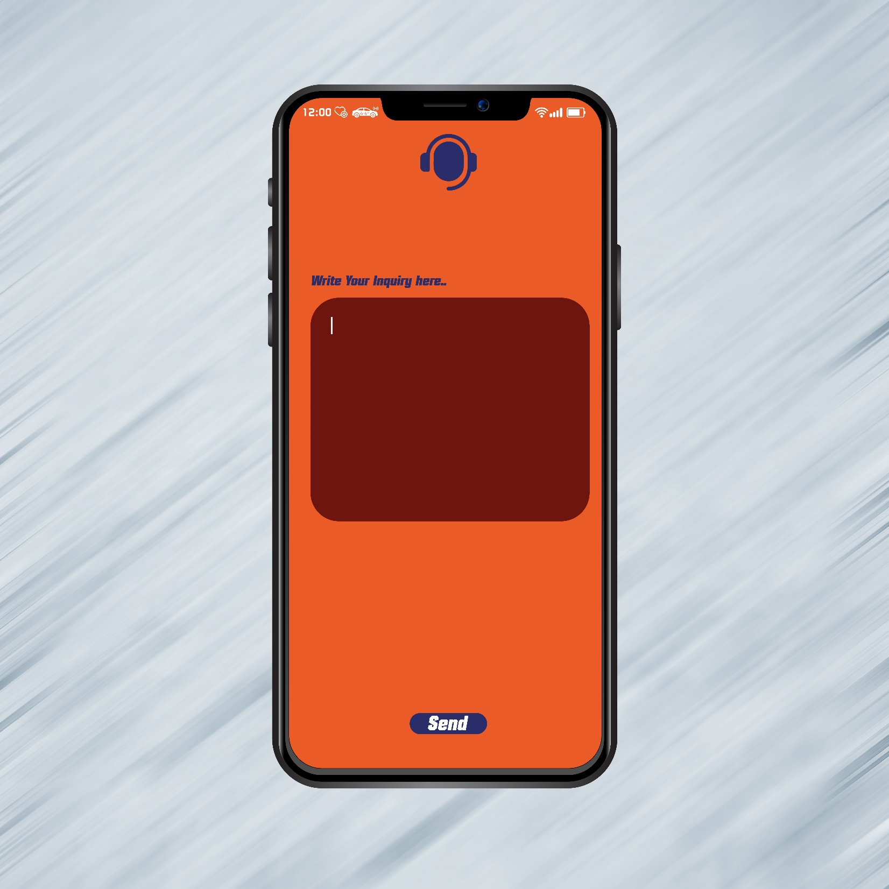
Software
Mobile Application
UI Design

Slide 57
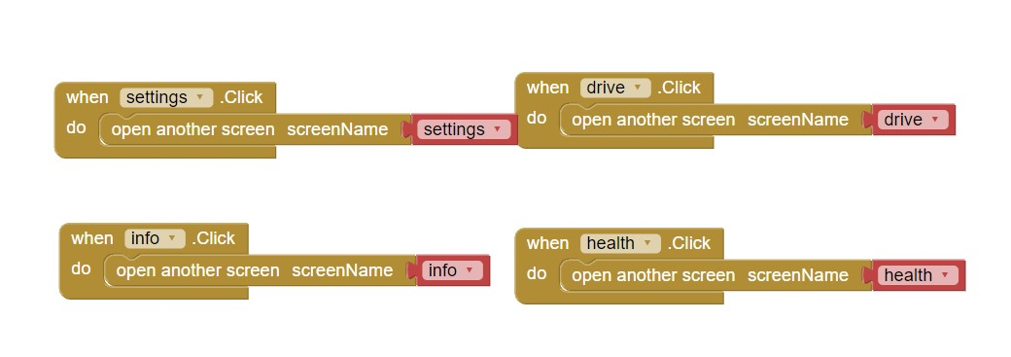
Software
Application Building
A preliminary application was designed by “MIT App Inventor” website until the project is developed further in the future, as we will know in the “future of the project” part.

Slide 58
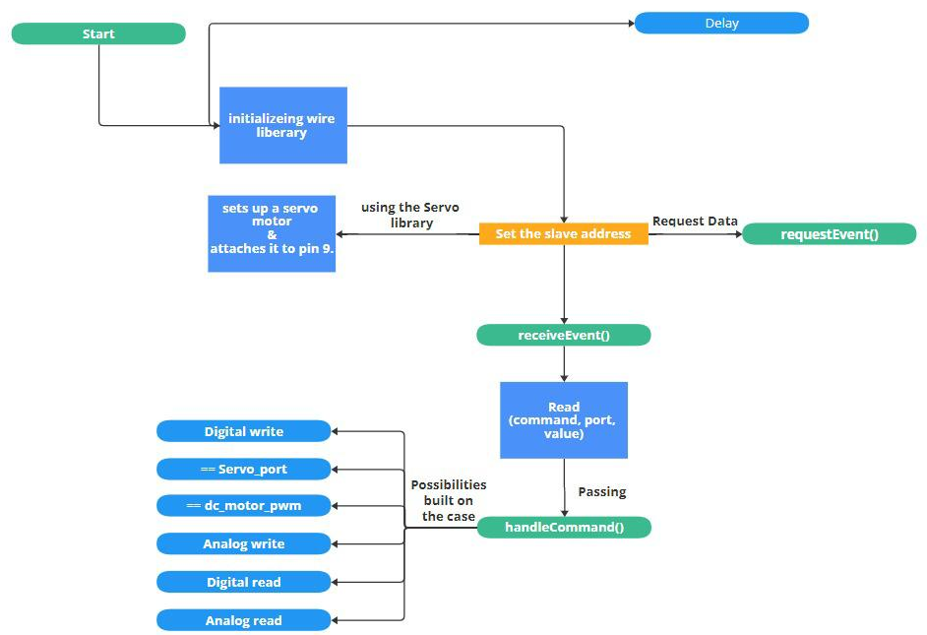
Arduino Coding
Software

Slide 59
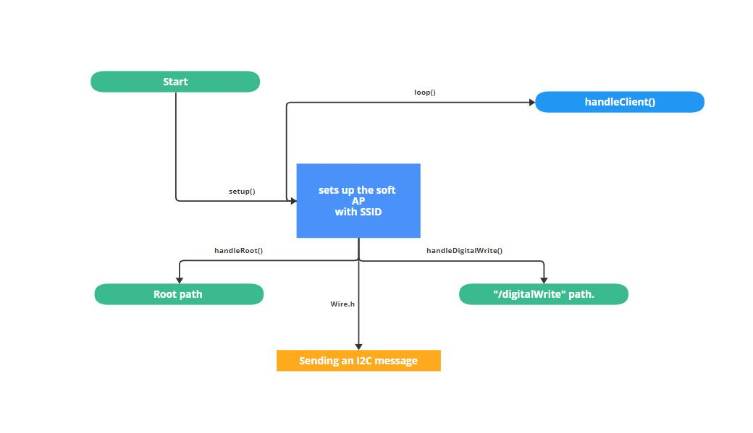
ESP-8266 Coding
Software

Slide 60
Future Of Project

Slide 61
Future
Future Plans
Artificial Intelligence
Emergency Response and Autonomous Driving
Driver Profiling
Driver Feedback
Cloud-Based Storage
Internet of Things (IoT)
Sensor Fusion Technology

Slide 62
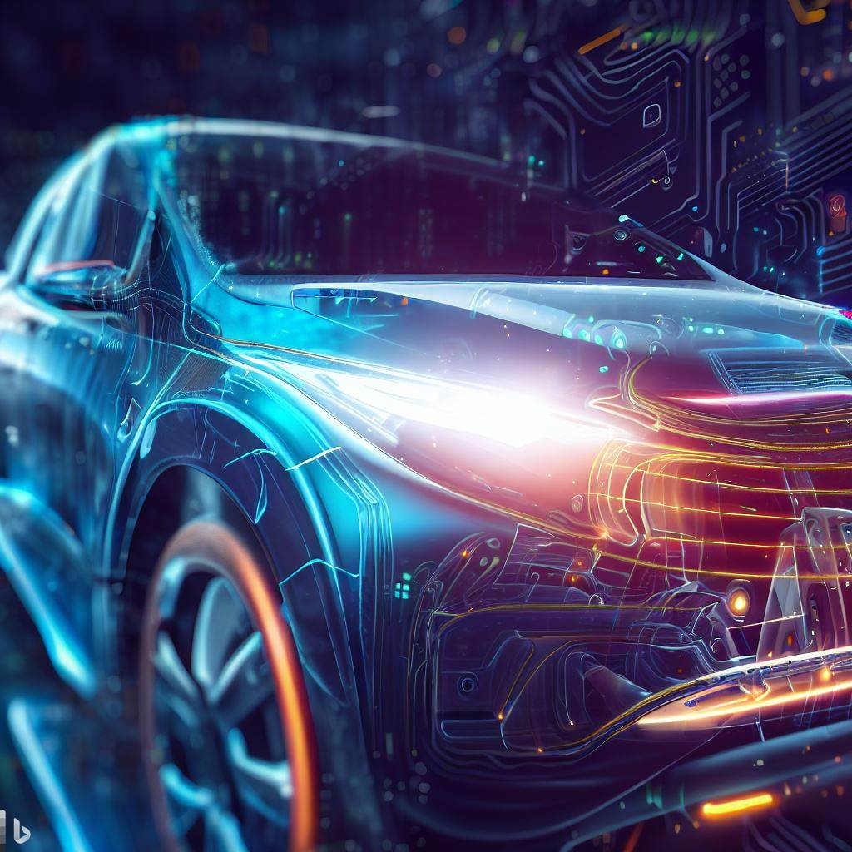
Future
Artificial Intelligence

Slide 63

Future
Emergency Response and Autonomous Driving

Slide 64

Future
Driver Profiling

Slide 65

Future
Driver Feedback

Slide 66

Future
Cloud-Based Storage

Slide 67
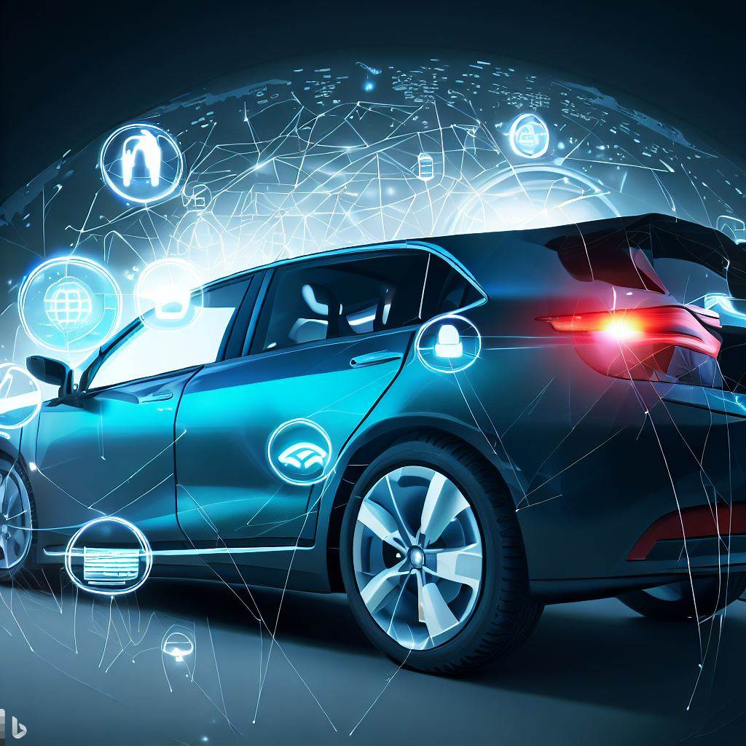
Future
Internet of Things (IoT)

Slide 68
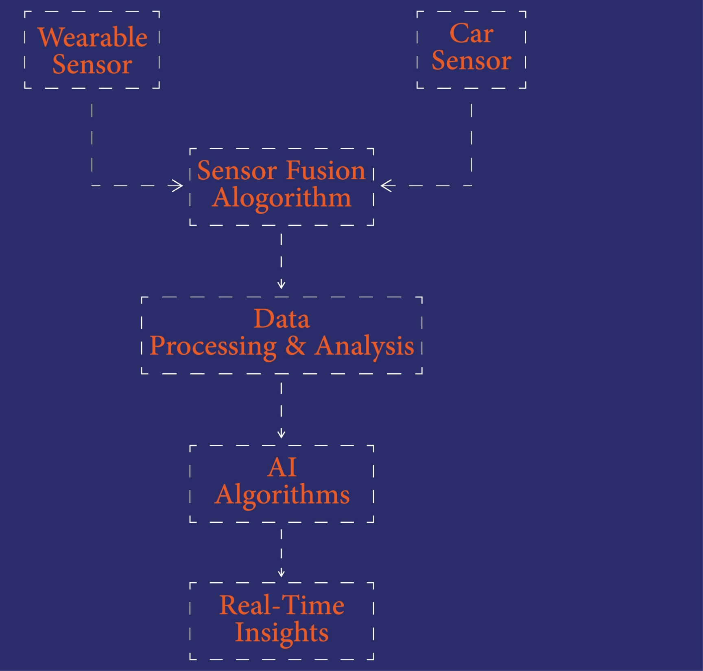
Sensor
Fusion
Technology
Future
Wearable Sensors
Sensor Fusion Algorithm
Car's Sensors
Data Processing and Analysis
Artificial Intelligence Algorithms
Real-time Insights

Slide 69
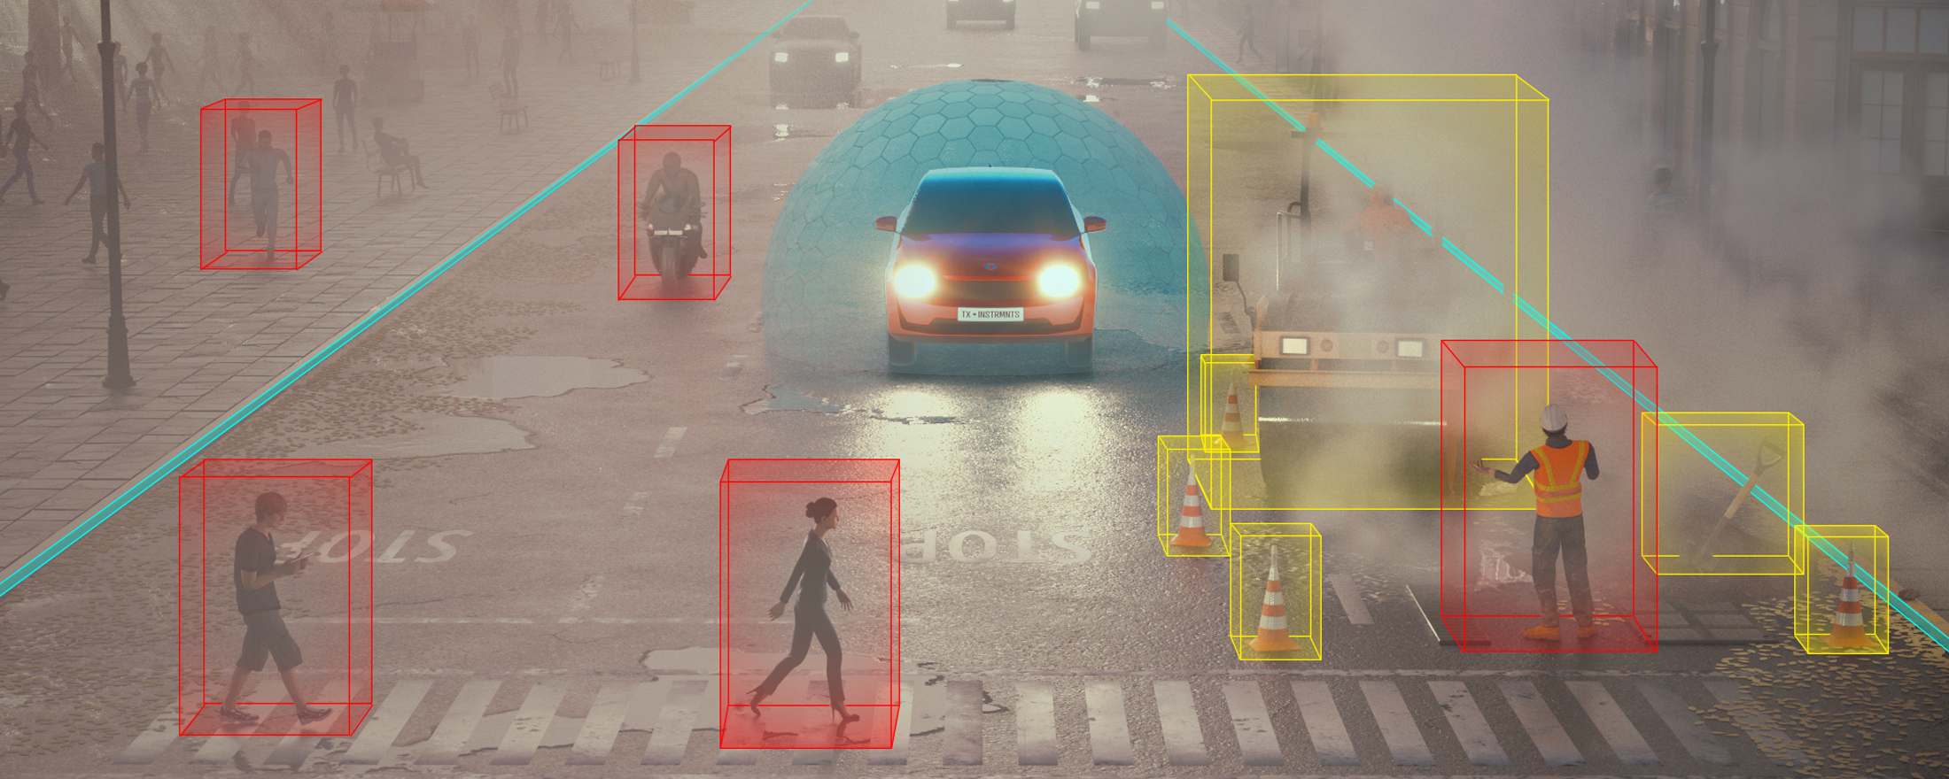
Sensor Fusion Technology
Future

Slide 70
Thanks…..

